Slide 1
The Methylation Landscape of Human Cancers
Methylation patterns of cancers using The Cancer Genome Atlas (TCGA) database
https://tcga-data.nci.nih.gov/tcga/

Slide 2
Talk Outline
PART #1: DNA Methylation
1. Introduction:
Biological background: DNA Methylation
Scientific Questions
Methodology: TCGA database, Illumina Platform
2. Preliminary data:
Methylation
Methylation & expression
PART #2: Integrating Mutation & Methylation
PART #3: Summary
2

Slide 3
The ‘fifth base’: 5-methylcytosine
Published in February 2001, the rough draft version of the human genome was widely heralded as the “book of life,” an ∼3-billion-letter code composed of just four letters within which is described our cellular and physiological complexity, and our genetic heritage… Yet the book was missing proper formatting of some of the characters within its pages; omitted from this landmark volume was the elusive and dynamic fifth letter of the code: 5-methylcytosine… commonly referred to as DNA methylation, is a modified base that imparts an additional layer of heritable information upon the DNA code, which is important for regulating the underlying genetic information.
Lister & Ecker, 2009

Slide 4
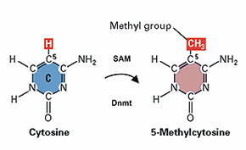
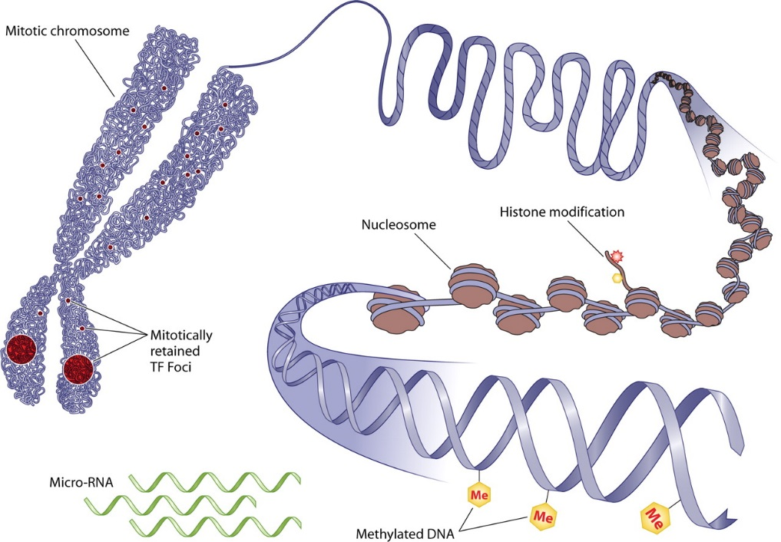
DNA Methylation
DNA methylation at CpG sites
Frequency: 1%–6% of mammalian & plant genomes (Montero et al. 1992)
Roles: heritable information, embryogenesis, development, genomic imprinting, silencing of transposable elements, protection from parasites, regulation of gene expression & splicing
Methylated sites ~ Expression
CpG methylation in promoter - negatively correlated w/ expression
70% of human promoters have a high CpG content
CpG Islands
300-3000bp, %GC>50%, OB/EX CpG>60%
Zaidi S K et al, 2010

Slide 5
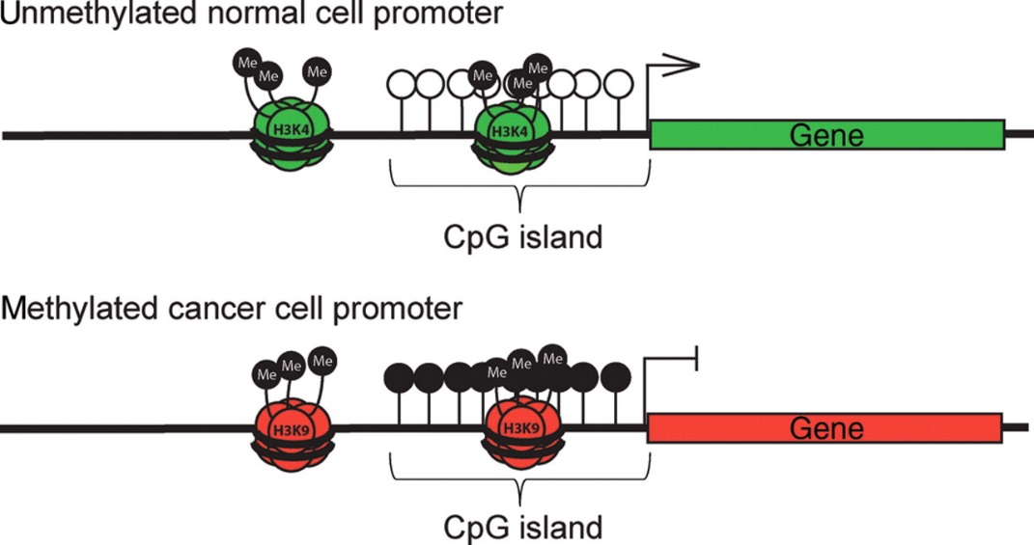
DNA Methylation in Disease
Carcinogenesis: differential methylation – silencing/activating transcription factors, genes, microRNAs, pathways
Most studies focus on methylation at gene promoters
Lahtz C , and Pfeifer G P J Mol Cell Biol 2011;3:51-58

Slide 6
Scientific Questions
Methylation
Examine methylation patterns across various cancers
Clustering cancers using methylation patterns; does methylation pattern identify similar cancers (e.g. of similar embryonic origin)?
Identify differentially methylated genes, are they unique to cancer or common to all cancers?
Expression ~ Methylation
Proof of principal: examine correlation between methylation and gene expression (esp. TSS, promoter)
Use expression to assist with identifying differentially methylated genes
Selected genes - perform enrichment analysis for implicated pathway
6
Notes:
6

Slide 7
Methodology: TCGA database
https://tcga-data.nci.nih.gov/

Slide 8
Methodology: ~7500 Methylation Datasets
 | Abbrev | Tumor | Normal | Origin
bladder urothelial carcinoma | BLCA | 185 | 20 | Epithelial
breast invasive carcinoma | BRCA | 679 | 98 | Mesenchymal
cervical & endocervical cancer | CESC | 163 | 3 | Epithelial
colon adenocarcinoma | COAD | 275 | 38 | Epithelial
colon & rectum adenocarcinoma | COADREAD | 371 | 45 | Epithelial
esophageal carcinoma | ESCA | 63 | 12 | Epithelial
glioblastoma multiforme | GBM | 125 | 1 | Neural
head & neck squamous cell carcinoma | HNSC | 373 | 50 | Epithelial
kidney clear cell carcinoma | KIRC | 299 | 160 | Epithelial
kidney papillary cell carcinoma | KIRP | 142 | 45 | Epithelial
brain lower grade glioma | LGG | 266 | 2 | Neural
liver hepatocellular carcinoma | LIHC | 125 | 50 | Epithelial
lung adenocarcinoma | LUAD | 437 | 32 | Epithelial
lung cancer | LUNG | 798 | 75 | Mesenchymal
lung squamous cell carcinoma | LUSC | 361 | 43 | Epithelial
pancreatic adenocarcinoma | PAAD | 65 | 9 | Epithelial
prostate adenocarcinoma | PRAD | 213 | 49 | Epithelial
rectum adenocarcinoma | READ | 96 | 7 | Epithelial
sarcoma | SARC | 85 | 4 | Mesenchymal
skin cutaneous melanoma | SKCM | 338 | 1 | Neural
stomach adenocarcinoma | STAD | 261 | 2 | Epithelial
thyroid carcinoma | THCA | 508 | 56 | APUD System
uterine corpus endometrioid carcinoma | UCEC | 401 | 46 | Epithelial
Tumor samples: 6629
Normal Samples: 848
8

Slide 9
Platform: Illumina Infinium HumanMethylation450 BeadChip Coverage: over 450,000 CpG sites, 99% of RefSeq genes, 96% of CpG Islands
Methodology: Uneven genomic distribution of DNA methylation
Gene regions
CpG Islands
 | TSS1500 | TSS200 | 5'UTR | Exon1st | GeneBody | 3'UTR
Island | 28553 | 39314 | 31360 | 26978 | 43054 | 2442
All | 84288 | 62577 | 65493 | 39368 | 175469 | 19731
 | 34% | 63% | 48% | 69% | 25% | 12%

Slide 10
Methodology: DNA Methylation Analysis
DNA methylation - measured on a β-distributed absolute scale 0-1
1) Calculate mean regional methylation level per gene/CpG region for tumor and normal samples
2) Calculate differential methylation (tumor vs. normal)
Tools for DNA methylation analysis using Illumina Methylation450 BeadChip :
NIMBL: MATLAB code - Numerical Identification of Methylation Biomarker Lists (Wessely & Emes, 2012)
IMA: an R package - Illumina Methylation Analysis (Wang et al., 2012)
α offset (by default, α = 100) regularize Beta value when meth. + unmeth. probe intensities are low

Slide 11
Talk Outline
PART #1: DNA Methylation
1. Introduction:
Biological background: DNA Methylation
Scientific Questions
Methodology: TCGA database, Illumina Platform
2. Preliminary data:
Methylation
Methylation & expression
PART #2: Integrating Mutation & Methylation
PART #3: Summary
11

Slide 12
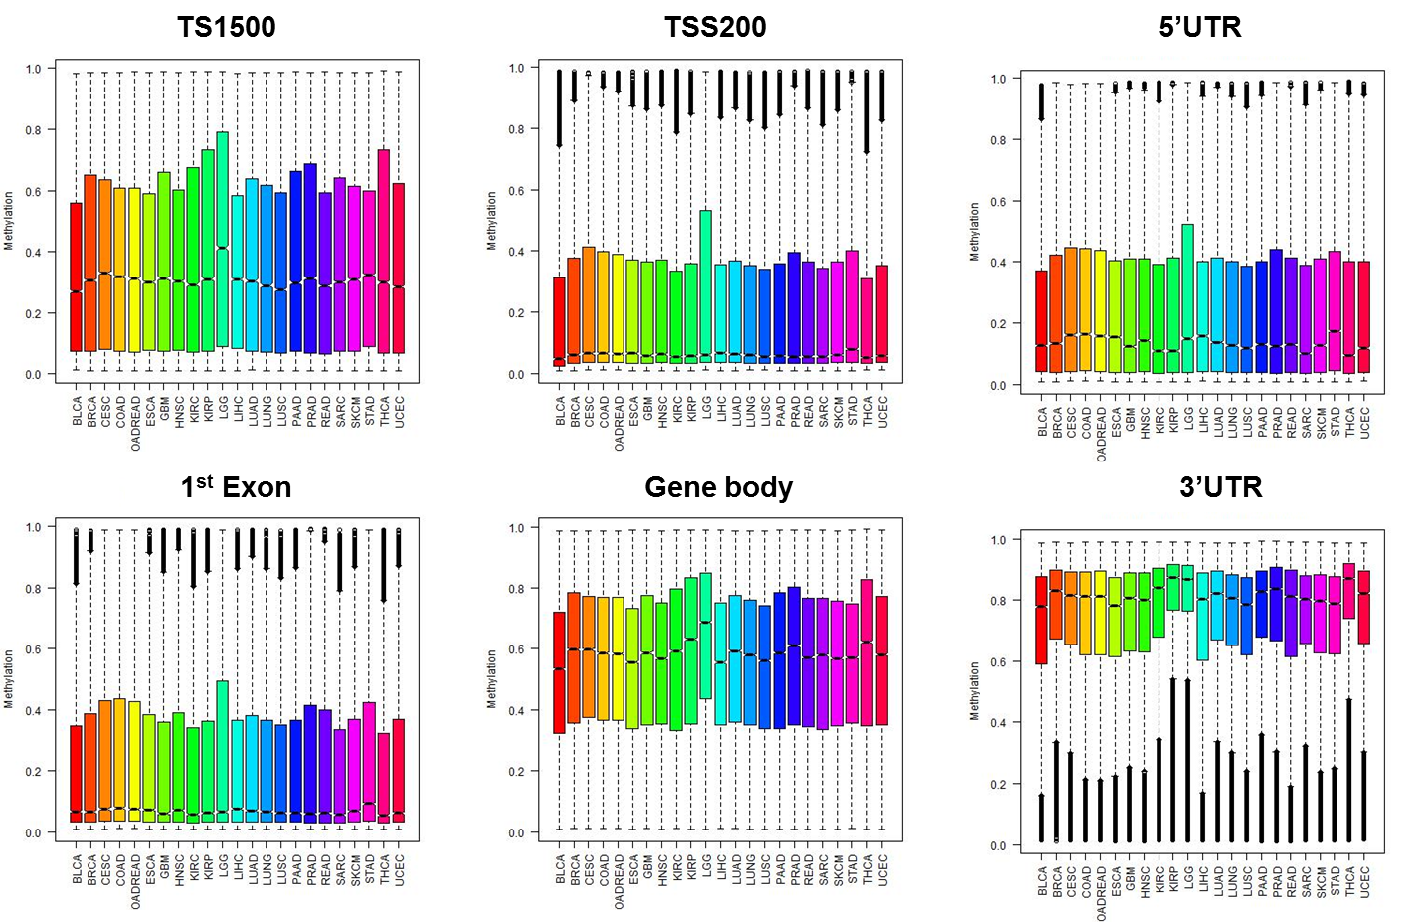
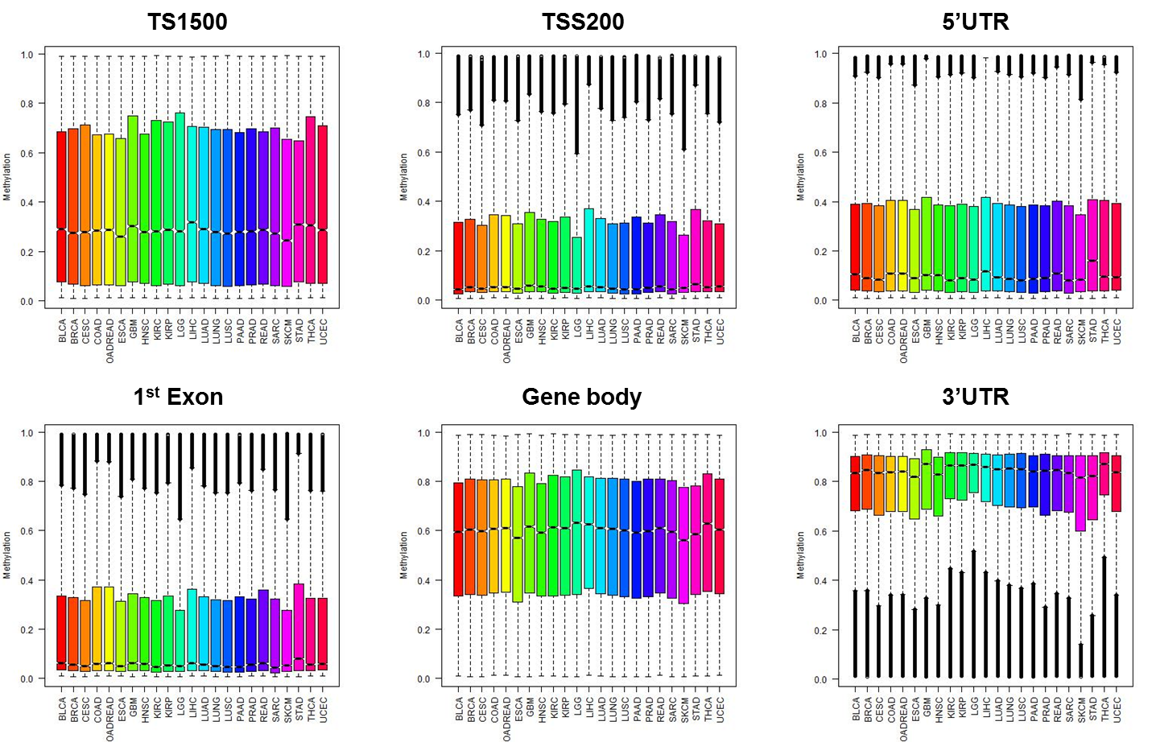
Normal & Tumor Methylation: Gene Regions
tumor
normal
12

Slide 13
Differential Methylation: Gene Regions
Next…
1) Differential Methylation of genes comparing beta values β(Normal) –β(Tumor)
2) All genes (no significance filtering)

Slide 14
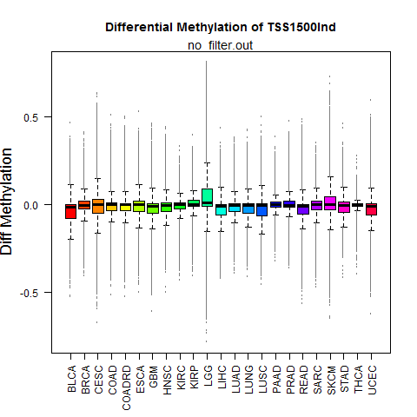
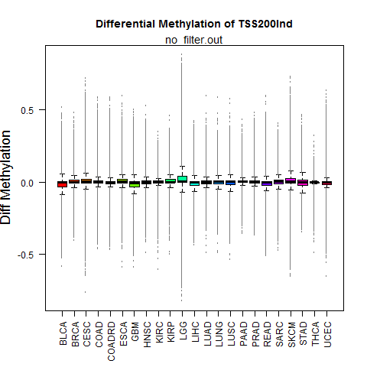
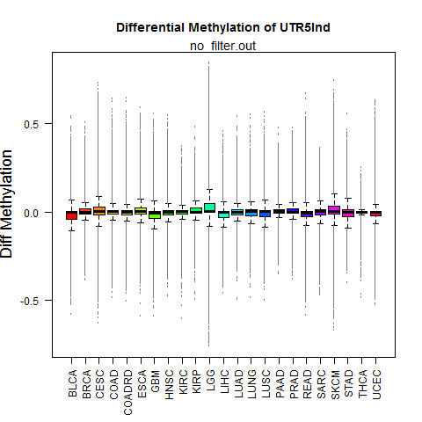
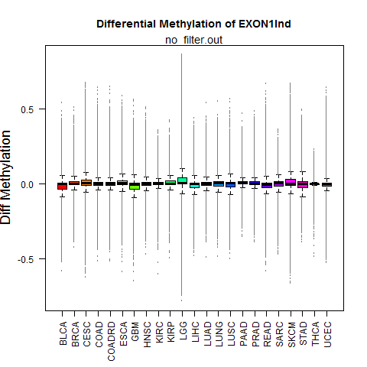
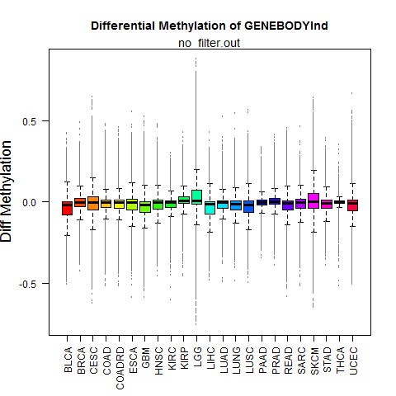
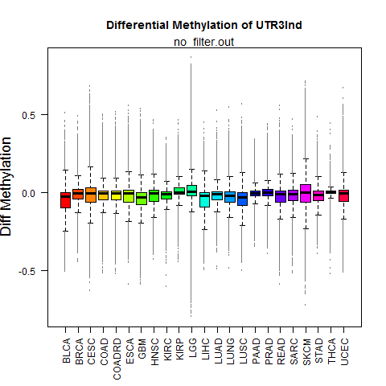
Differential Methylation: Gene Regions
TSS1500 TSS200 5’UTR
All genes (no filtering)
1st Exon Gene Body 3’UTR

Slide 15
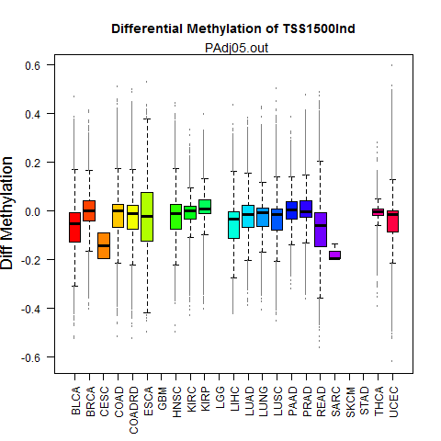
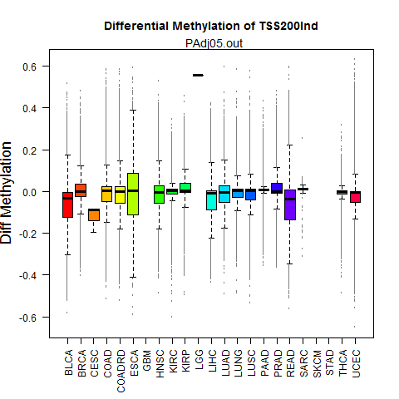
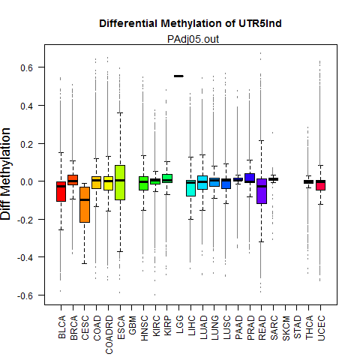
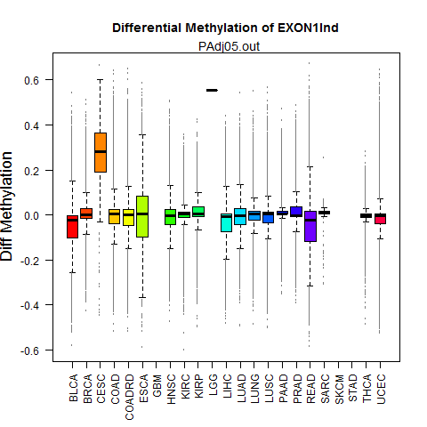
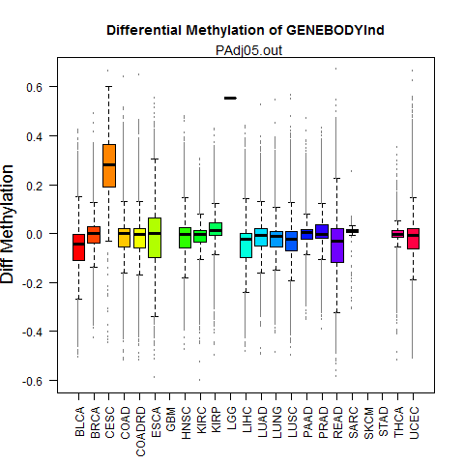
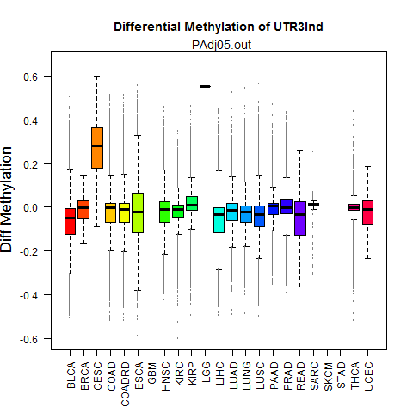
Differential Methylation: Gene Regions
Adjusted P< 0.05
TSS1500 TSS200 5’UTR
1st Exon Gene Body 3’UTR

Slide 16
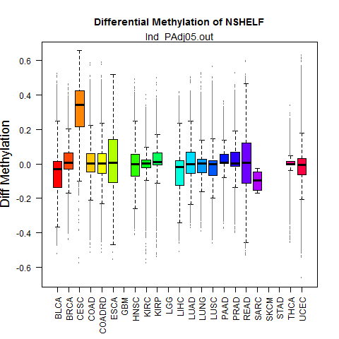
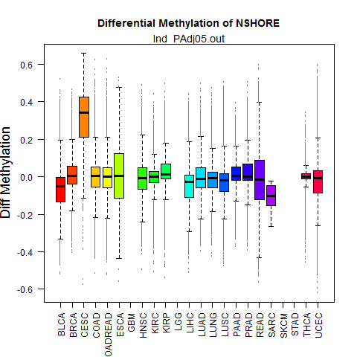
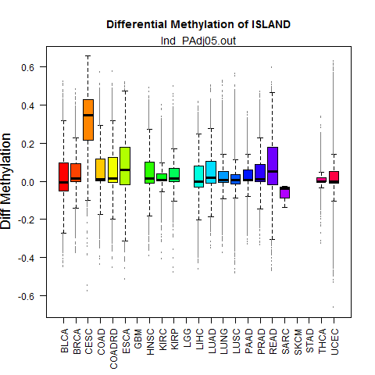
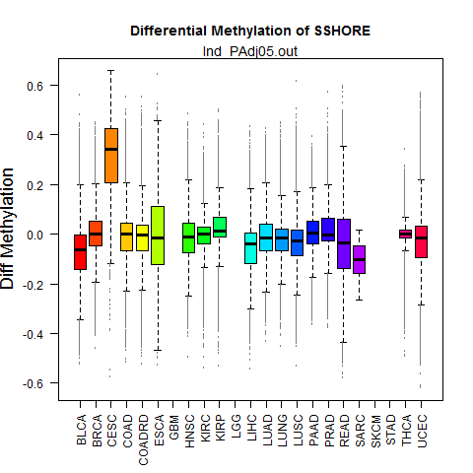
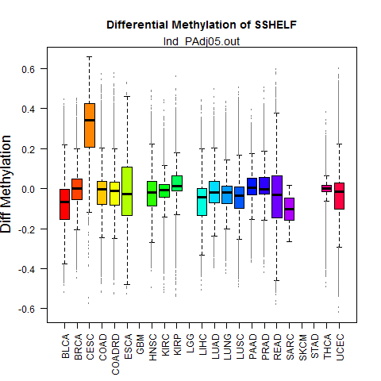
Differential Methylation: CpG Islands & flanking Regions
Adjusted P< 0.05
N Shelf N Shore CpG Island S Shore S Shelf

Slide 17
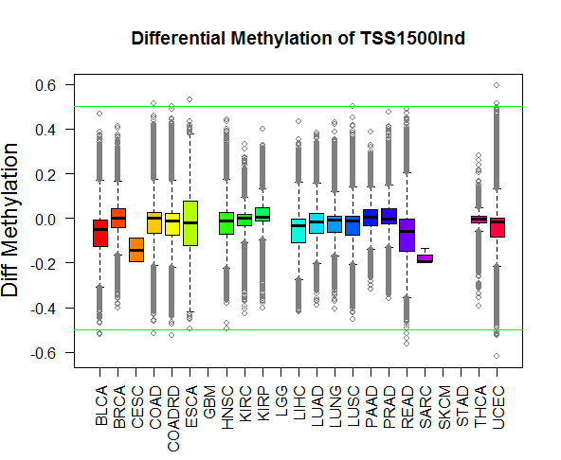
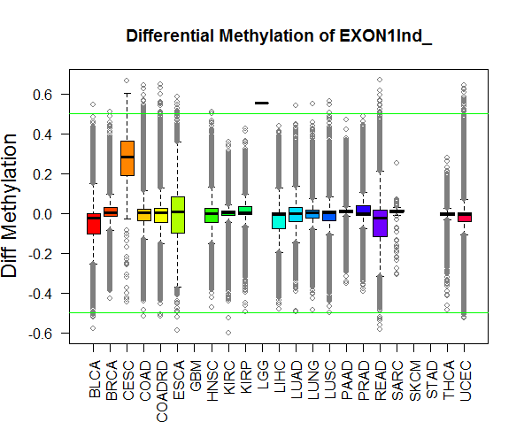
Interpretations
Different methylation patterns in different gene regions
Cancers differ in degree of differential methylation - which may play more major (or minor) role in specific cancer
Variation in # of hypo/hyper-methylated genes – could indicate differences in enzymatic activity

Slide 18
Next - Proof of principle
Integrating expression data with methylation data
Goal:
recapitulate previous studies showing a negative correlation between promoter methylation and gene expression

Slide 19
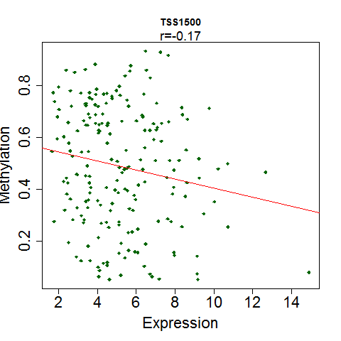
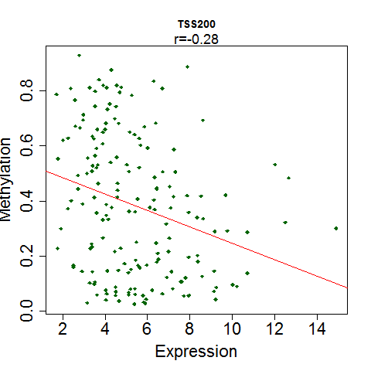
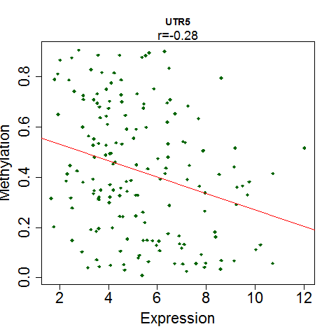
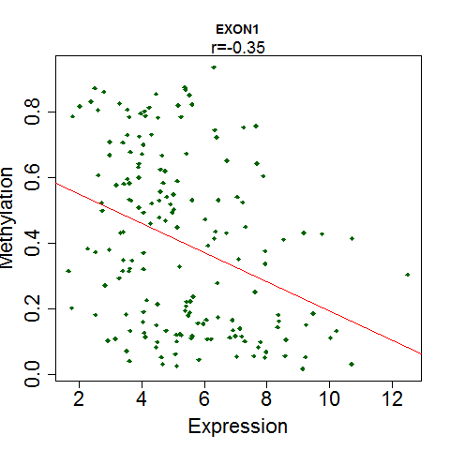
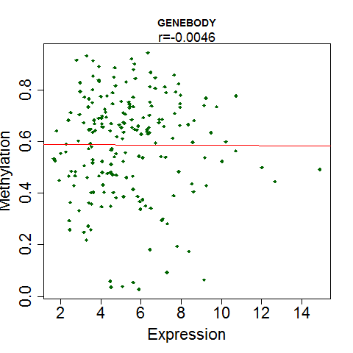
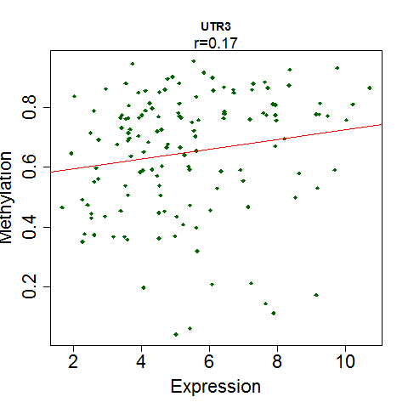
Correlation between Expression Methylation
Example:
SKCM
Genes were filtered using std>3 on expr.
TSS1500 TSS200 5’UTR
r=-0.17 r=-0.28 r=-0.28
1st Exon Gene body 3’UTR
r=-0.35 r=-0.0046 r=0.17

Slide 20
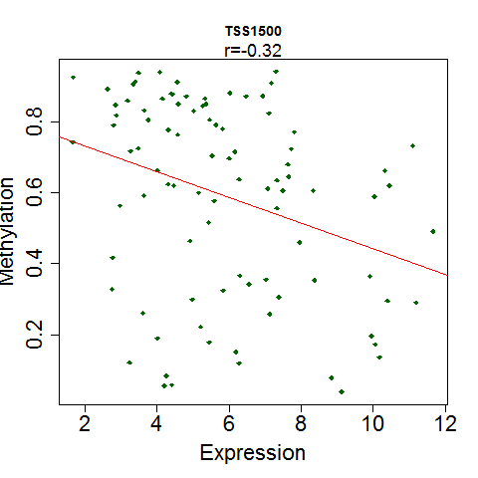
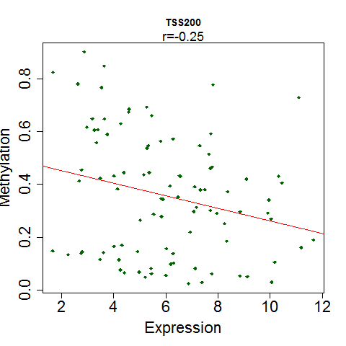
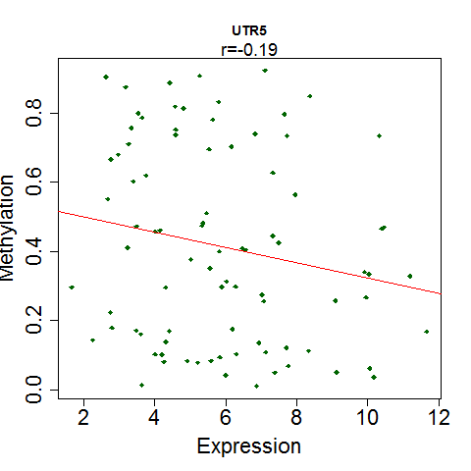
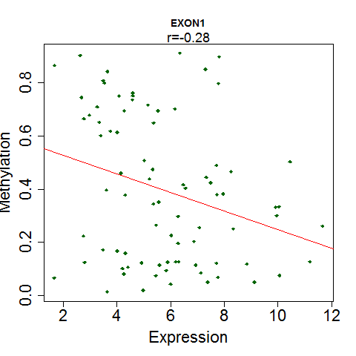
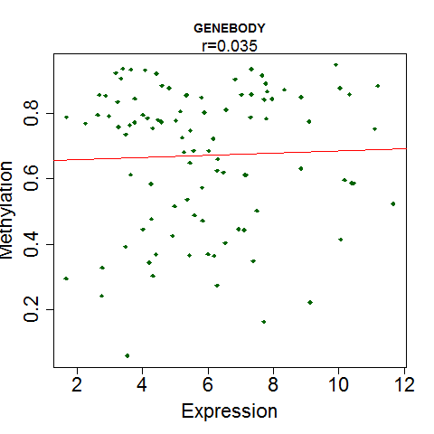
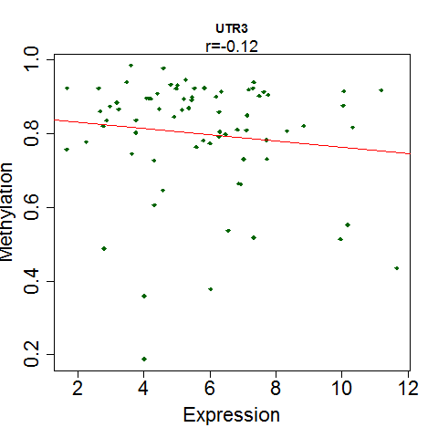
Correlation between Expression Methylation
Example:
KIRP
Genes were filtered using std>3 on expr.
TSS1500 TSS200 5’UTR
r=-0.32 r=-0.25 r=-0.19
1st Exon Gene body 3’UTR
r=-0.28 r=-0.035 r=-0.12

Slide 21
Questions for audience
Differential methylation: threshold? P-value? I.e. single cutoff for all cancers or select outlier per cancer
Methylation: loss of data from samples with <5 normal samples
Improve - integration of methylation and expression data to select genes?
Gene methylation across different regions, correlation across different regions

Slide 22
Talk Outline
PART #1: DNA Methylation
1. Introduction:
Biological background: DNA Methylation
Scientific Questions
Methodology: TCGA database, Illumina Platform
2. Preliminary data:
Methylation
Methylation & expression
PART #2: Integrating Mutation & Methylation
PART #3: Summary
22

Slide 23
Cancer Mutations
Somatic mutation calls
Synonymous: Silent mutations
Non-Synonymous: Missense, nonsense, frame-shift (indels), splice-site within protein coding region
Copy number variation (CNV): e.g. deletions, insertions, duplications, inversions
Challenge: identify driver vs. passenger mutations
‘‘driver’’ mutations – confer(ed) fitness advantage to tumor cell
‘‘passenger’’ mutations - never conferred fitness advantage
Tools developed in Broad Inst.: MuTect (Cibulskis et al. 2013), Indelocator, MutSigCV (Lawrence et al., 2013), InvEx (Hodis et al., 2012)
Driver mutations mainly consider protein coding regions

Slide 24
Scientific Questions: Methylation & Mutations
1. Driver mutations
Identify mutated CpG are drivers, i.e. have functional implications (use conservation? expression?)
2. Methylation and mutations
Are they related? Do they show associations? Do coding and non-coding genes differ?

Slide 25
Scientific Questions: Methylation & Mutations
1. Driver mutations
Identify mutated CpG are drivers, i.e. have functional implications (use conservation? expression?)
2. Methylation and mutations
Are they related? Do they show associations? Do coding and non-coding genes differ?
transcription-repair coupling
Expression & mutation are related
Low expression -> more mutations
High expression -> less mutations
Lawrence et al., Nature, 2013

Slide 26
Scientific Questions
Methylation & Mutations
1. Driver mutations
Identify mutated CpG are drivers, i.e. have functional implications (use conservation? expression?)
2. Methylation and mutations
Are they related? Do they show associations? Do coding and non-coding genes differ?
3. Effect of cancer mutations on CpG landscape
Do mutations/CNVs change frequency of CpG sites? Effect on methylation?
4. Cancer heterogeneity
Tumor clones harbor different lesions, does methylation similarly differ between clones?

Slide 27
Talk Outline
PART #1: DNA Methylation
1. Introduction:
Biological background: DNA Methylation
Scientific Questions
Methodology: TCGA database, Illumina Platform
2. Preliminary data:
Methylation
Methylation & expression
PART #2: Integrating Mutation & Methylation
PART #3: Summary
27

Slide 28
Summary
Methylation
Variation in differential methylation patterns across cancers and regions
Cancers defer in amount of hypo-/hyper-methylated genes
Recapitulated negative correlation between promoter methylation and expression
Future Directions
1. Methylation & Expression
a. Examine relationship between methylation and expression (per gene region)
b. Integrate methylation & expression data to identify diff. methylated genes
2. Methylation & Mutation
a. Integrate methylation & mutation data to identify “driver” CpG mutations
b. examine effect of cancer mutations on CpG & methylation
3. Integration Methylation, Mutation & Expression
28
Notes:
28

Slide 29
Acknowledgements
Dr. Carmit Levy and lab members
Prof. Ron Shamir
Dvir Netanely
Sahar Gelfman
Prof. Gil Ast
Thank you for listening

Slide 30
Thank you for listening

Slide 32
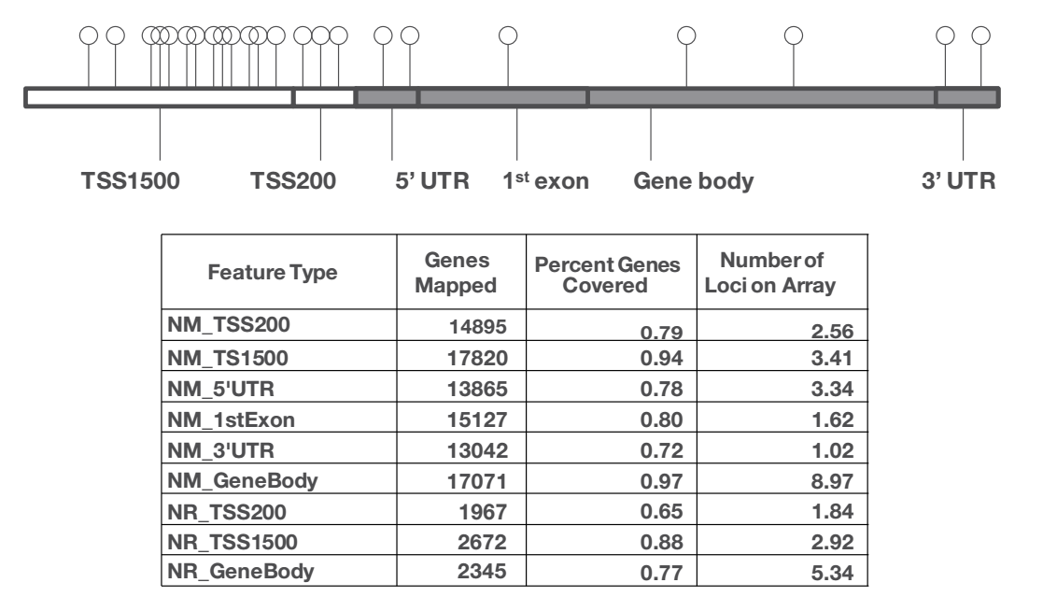
Illumina Platform Infinium HumanMethylation450 BeadChip
32

Slide 33
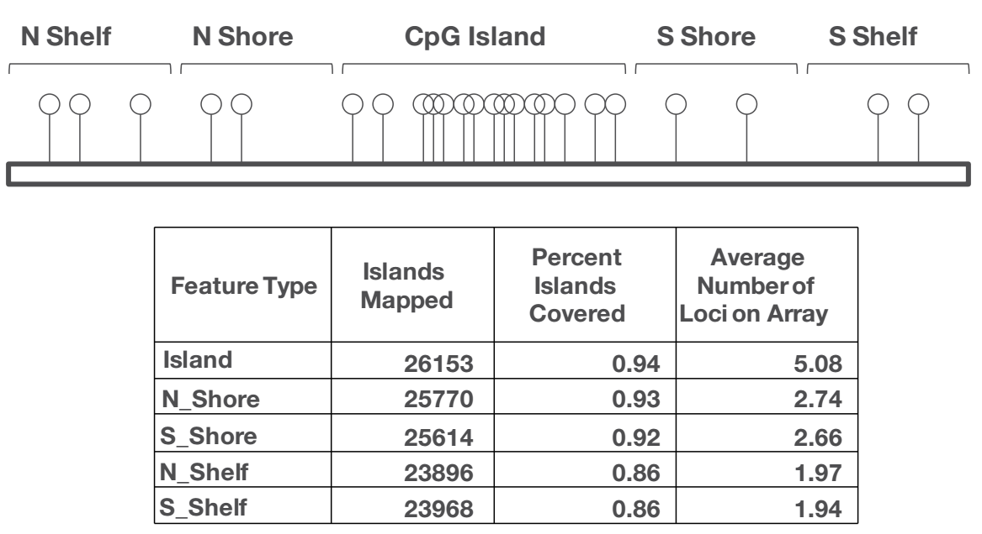
Illumina Platform Infinium HumanMethylation450 BeadChip
33

Slide 34
Methodology: DNA Methylation Analysis
Illumina Methylation Analyzer (IMA)
Calculates Differential methylation for 5’ UTR, first exon, gene body, 3’ UTR, CpG island, CpG shore, CpG shelf
Mean, Median, Tukey’s Biweight robust average
Identifies DMRs in regions
Wilcoxon rank-sum test
Student’s t-test
Empirical Bayes
Generalized linear models
Multiple Testing Correction
Bonferroni
False Discovery Rate

Slide 35
Introduction: Publication limitations
Tumor Type | Data Status
Acute Myeloid Leukemia (AML) | No restrictions; all data avail. w/out limitations
Breast cancer (BRCA) | As above
Clear cell carcinoma (KIRC) | As above
Colon and rectal adenocarcinoma (COAD, READ) | As above
Cutaneous melanoma (SKCM) | As above
Glioblastoma multiforme (GBM) | As above
Head and neck squamous cell carcinoma (HNSC) | As above
Lung adenocarcinoma (LUAD) | As above
Lung squamous cell carcinoma (LUSC) | As above
Ovarian serous cystadenocarcinoma (OV) | As above
Stomach adenocarcinoma (STAD) | As above
Thyroid carcinoma (THCA) | As above
Uterine corpus endometrial carcinoma (UCEC) | As above
Projects with limitations until specific dates or until a marker paper is published, whichever comes first.Please contact tcga@mail.nih.gov before publishing.
Chromophobe renal cell carcinoma (KICH) | Publication limitations until 12/12/2013
Bladder cancer (BLCA) | Publication limitations until 12/27/2013
Lower Grade Glioma (LGG) | Publication limitations until 3/11/2014
Prostate adenocarcinoma (PRAD) | Publication limitations until 3/11/2014
Kidney papillary carcinoma (KIRP) | Publication limitations until 06/20/2014
Liver hepatocellular carcinoma (LIHC) | Publication limitations until 07/31/2014
Cervical squamous cell carcinoma (CESC) | Publication limitations until 09/27/2014
Uterine carcinosarcoma (UCS) | Publication limitations until 10/31/2014
Adrenocortical carcinoma (ACC) | Publication limitations until 11/09/2014
Projects that have not yet shipped 50% expected cases; Please check with prior to publication.
Diffuse large B-cell lymphoma (DLBC), Esophageal cancer (ESCA), Mesothelioma (MESO), Pancreatic adenocarcinoma (PAAD), Pheochromocytoma/Paraganglioma (PCPG), Sarcoma (SARC) |  | Projects have not reached 100 cases; Please check with prior to any publication

Slide 36
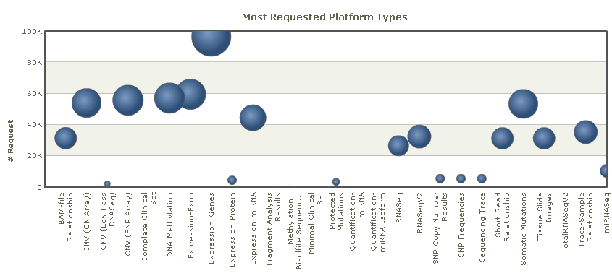
Methodology: TCGA database
Data types
Cancer types

